Slide 1
Microglia regulation of sleep homeostasis
Joe Stucynski, Data Visualization, 11/9/22

Slide 2
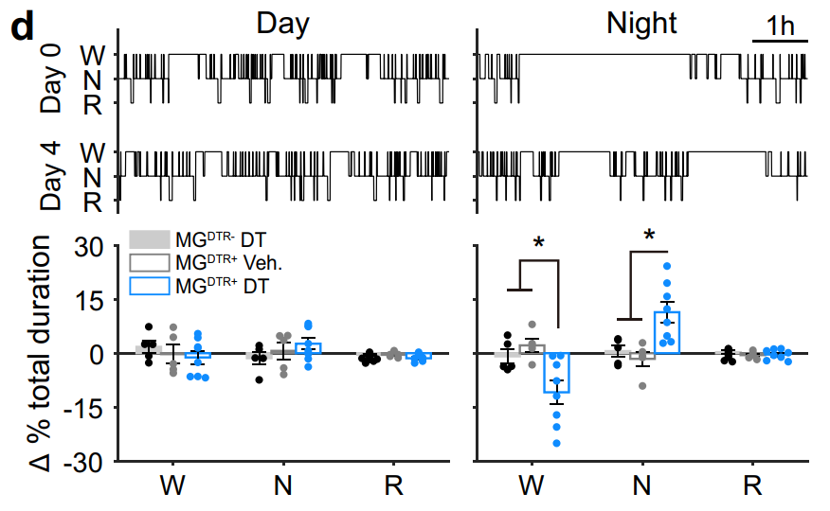
Microglia depletion affects sleep / wake architecture
Sleep period
Wake period
Loss of sleep/wake stability
Liu et al. 2021

Slide 3
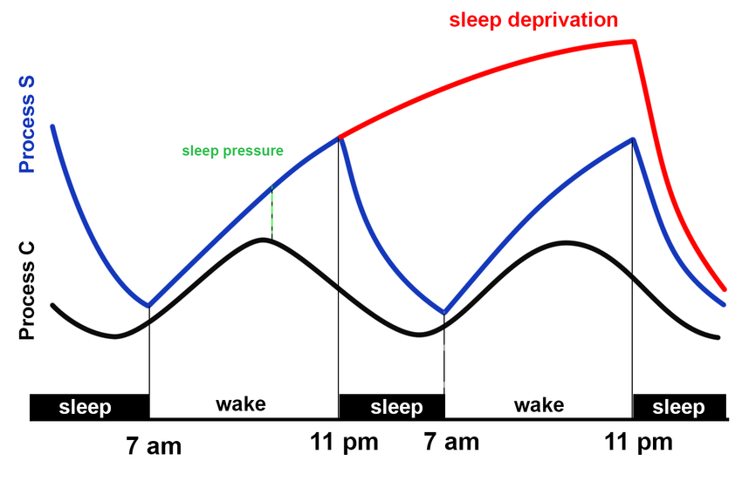
General Hypothesis: Microglia depleted mice have impaired homeostatic responses to sleep deprivation.
Null Hypothesis:
Depleting microglia does not affect sleep homeostasis.
sleep rebound
Specific Hypotheses:
Microglia depleted mice have elevated EEG delta power during recovery sleep.
Delta power takes longer to return to baseline than control mice.

Slide 4
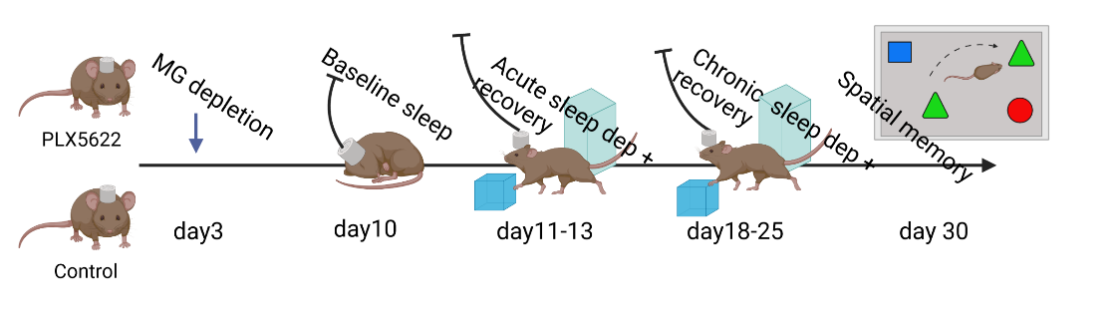
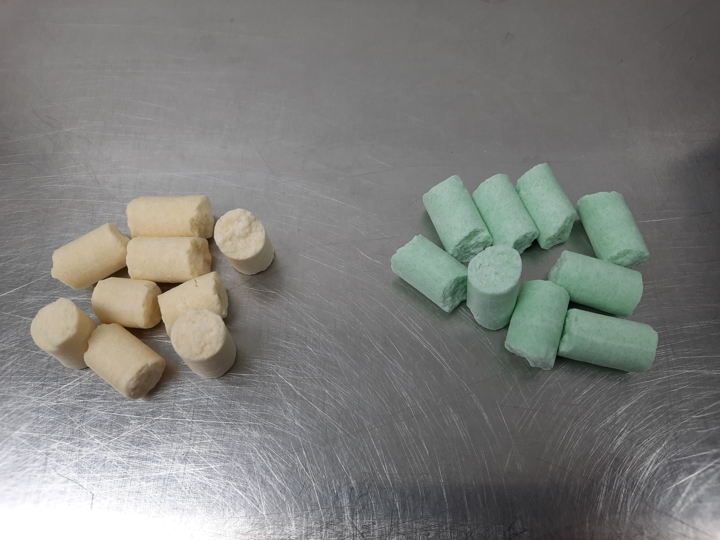
Experimental design
Day 1
Day 7
Day 8
Post depletion baseline
Dep.
Recovery
0
6
12
24
30
36
48

Slide 5
Experimental design
Day 1
Day 7
Day 8
Post depletion baseline
Dep.
Recovery
0
6
12
24
30
36
48

Slide 6
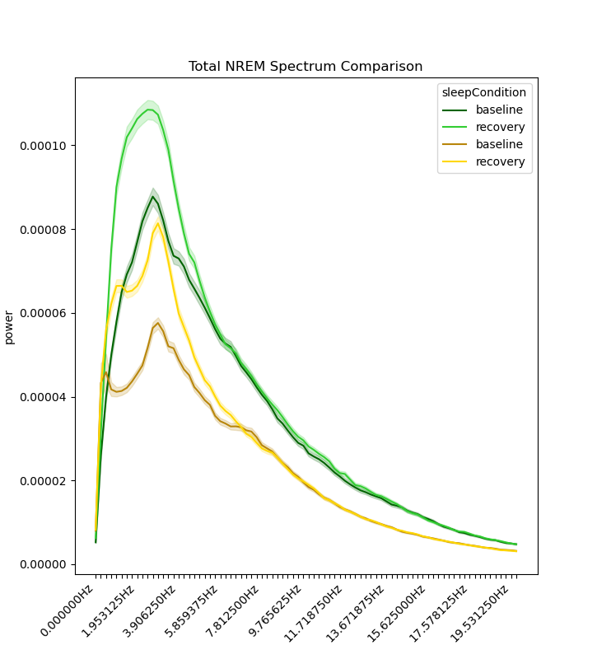
NREM Sleep Power Spectrum Across Conditions
Mice 1-8
Power (mV^2)
Frequency (Hz)

Slide 7
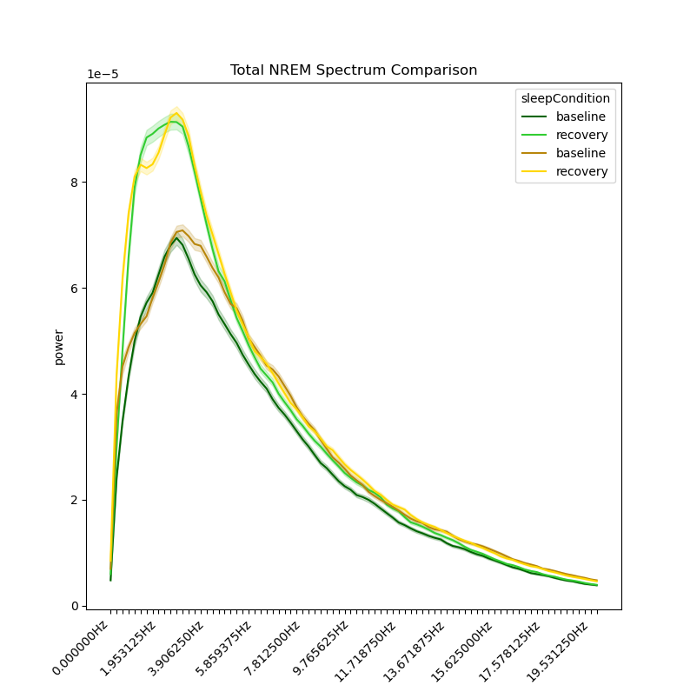
NREM Sleep Power Spectrum Across Conditions
Mice 1-8
Mice 1-16
Power (mV^2)
Power (mV^2)
Frequency (Hz)
Frequency (Hz)

Slide 8
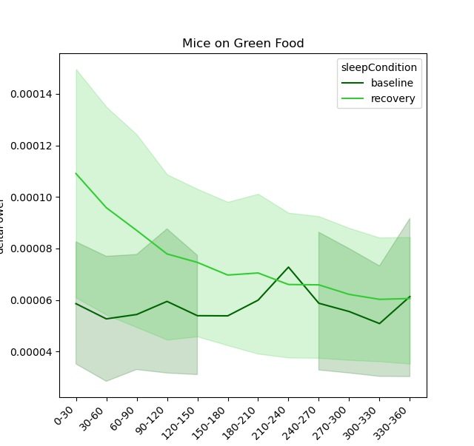
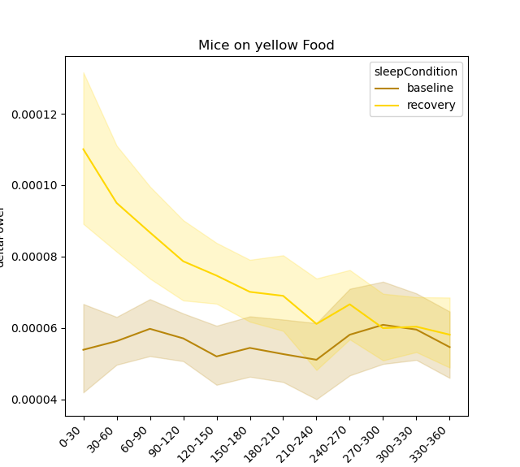
Raw Delta Power during NREM Sleep Across 6 hours
Power (mv^2)
Power (mv^2)
Time (30min bins)
Time (30min bins)

Slide 9
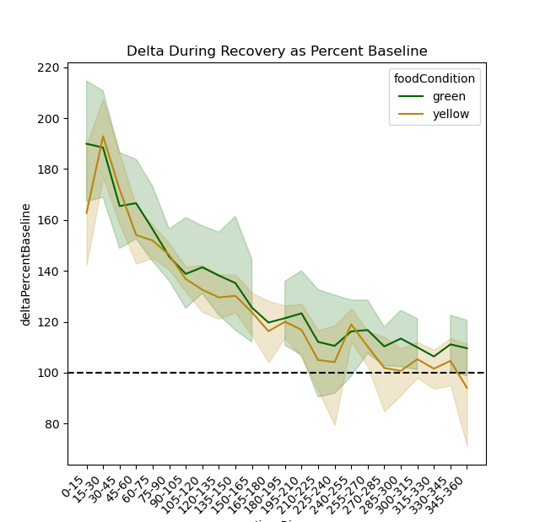
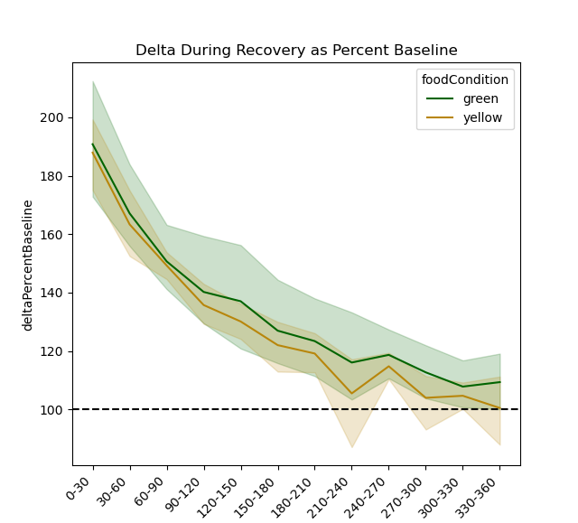
Normalized Delta Power during NREM Sleep Across 6 hours
% of baseline delta power
% of baseline delta power
Time (30min bins)
Time (15min bins)

Slide 10
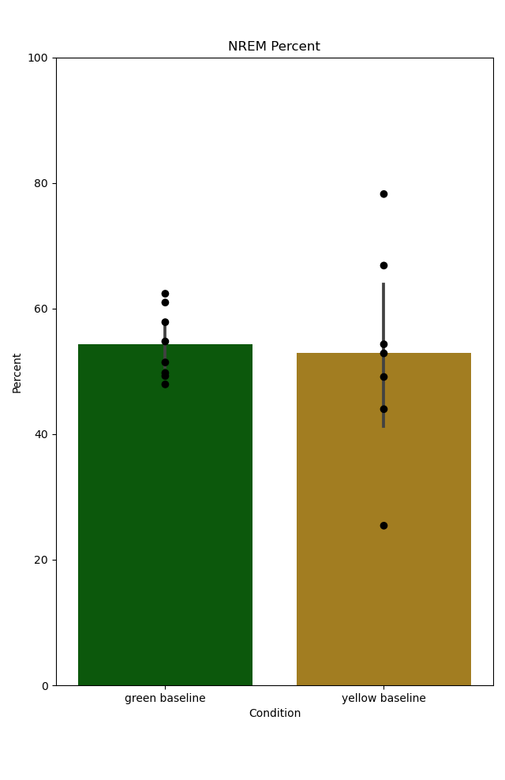
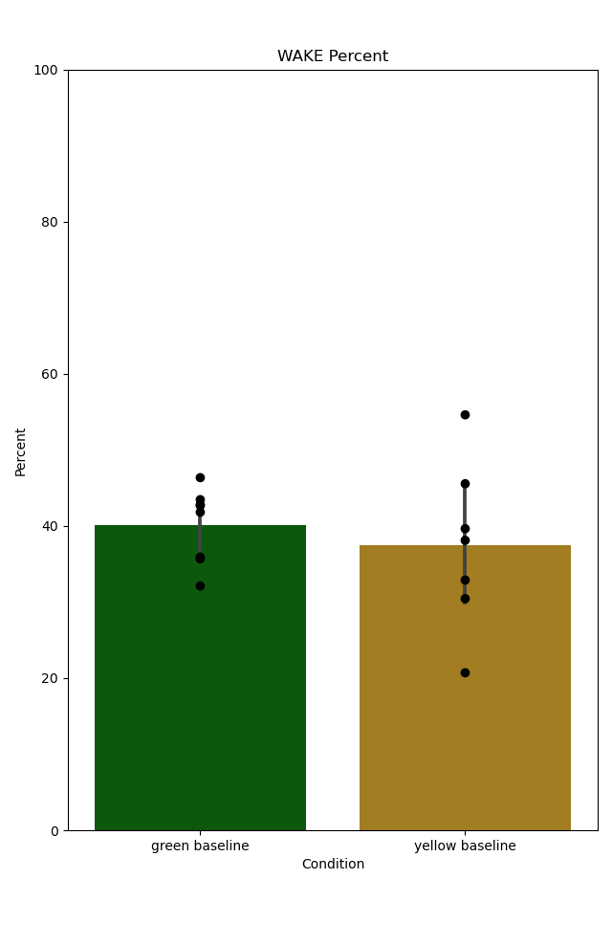
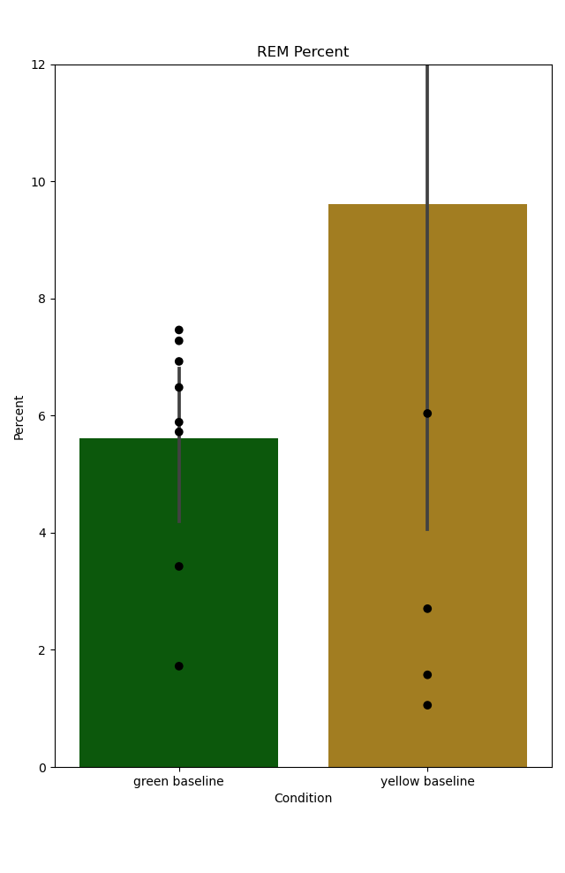
Sleep Summary Statistics
Baseline Percentages
NREM
Wake
REM

Slide 11
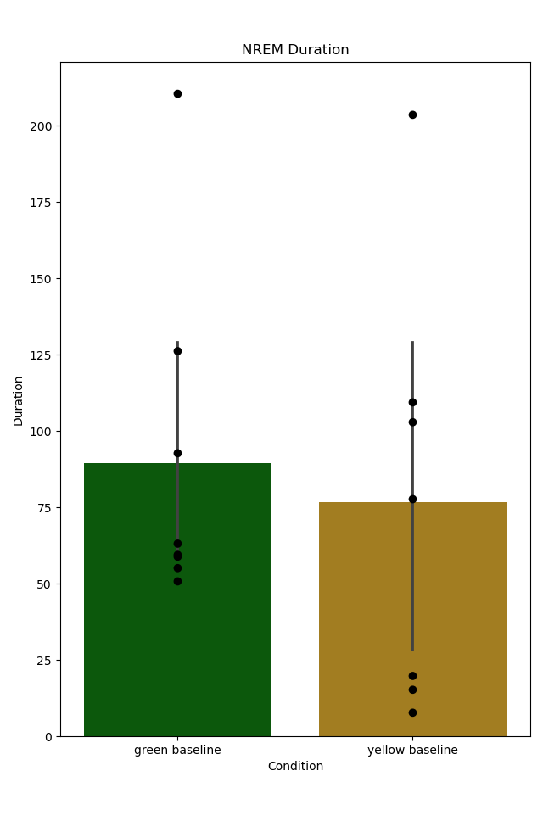
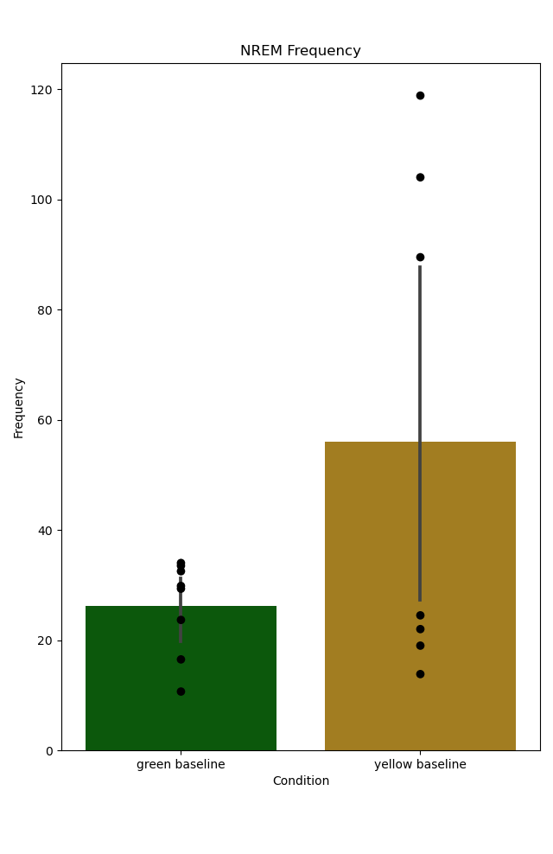
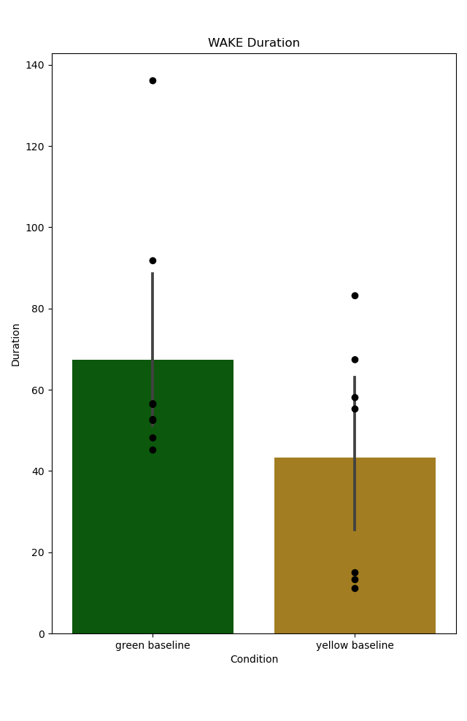
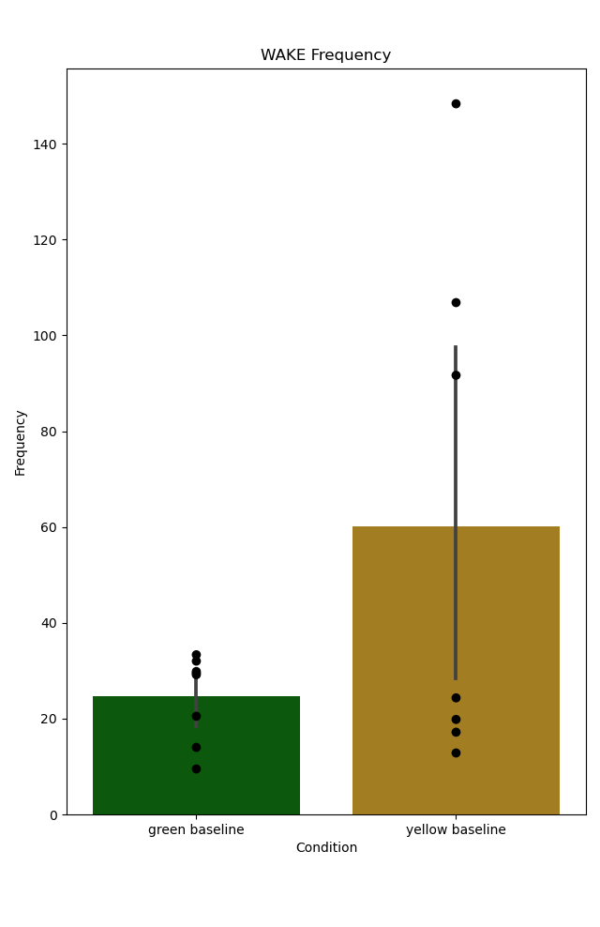
Sleep Summary Statistics
Baseline Bout Frequencies and Durations
NREM
Wake
Frequency (Bouts per hour)
Frequency (Bouts per hour)
Bout Duration
Bout Duration

Slide 12
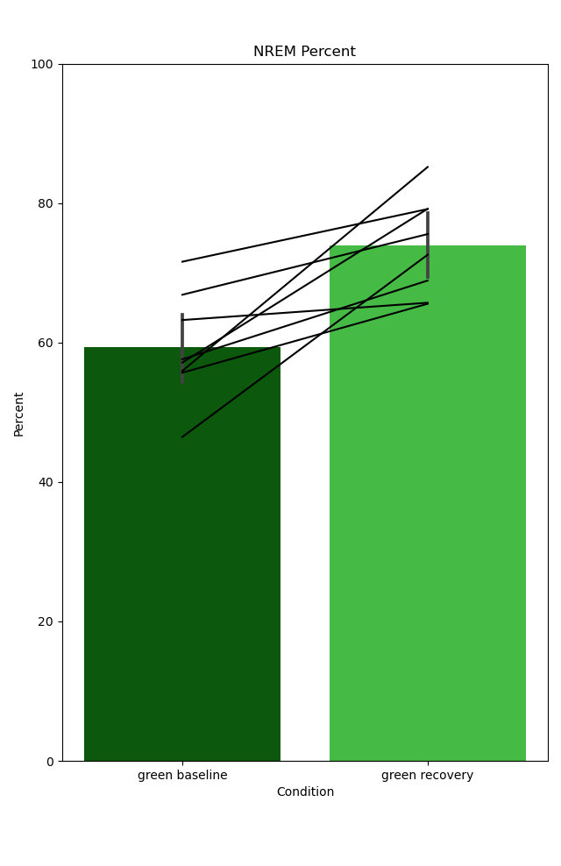
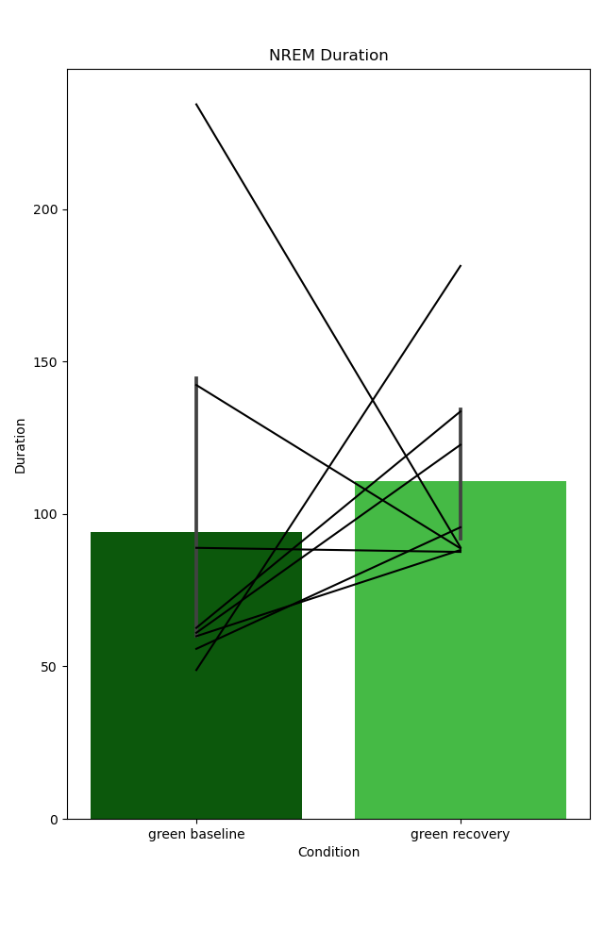
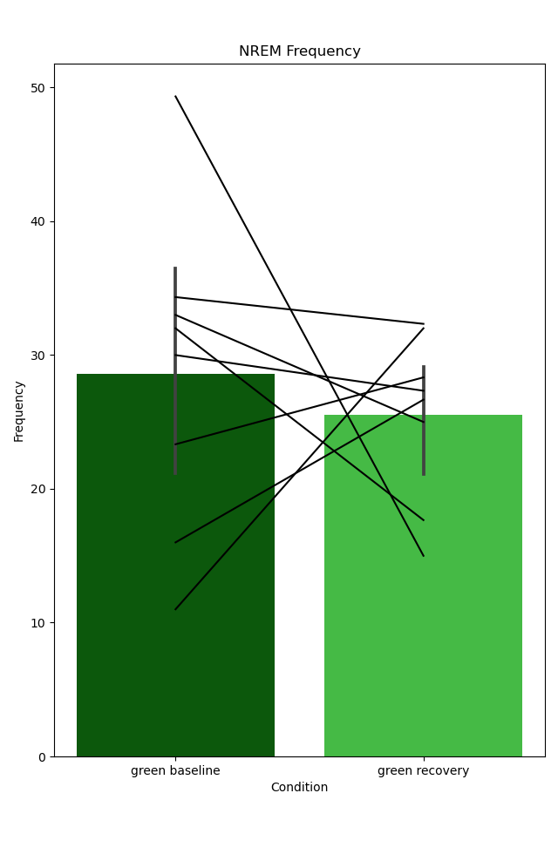
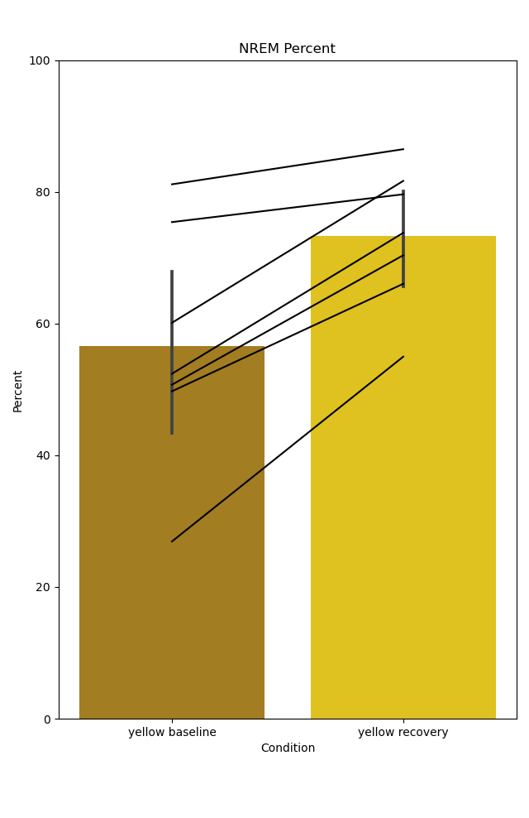
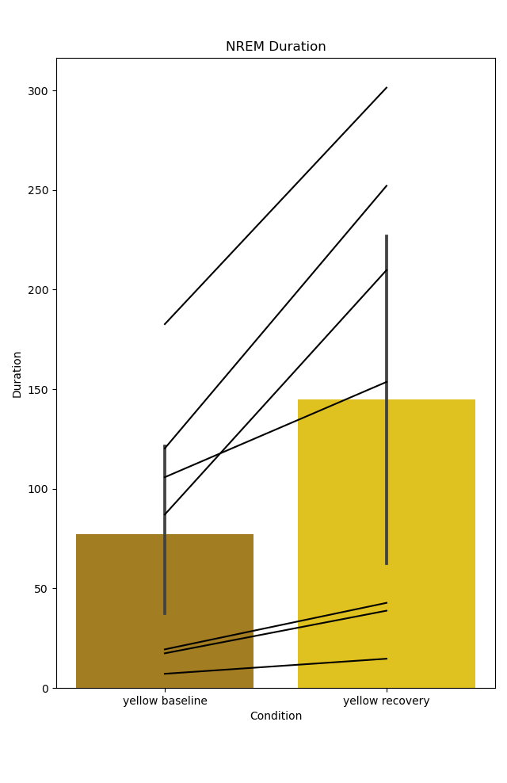
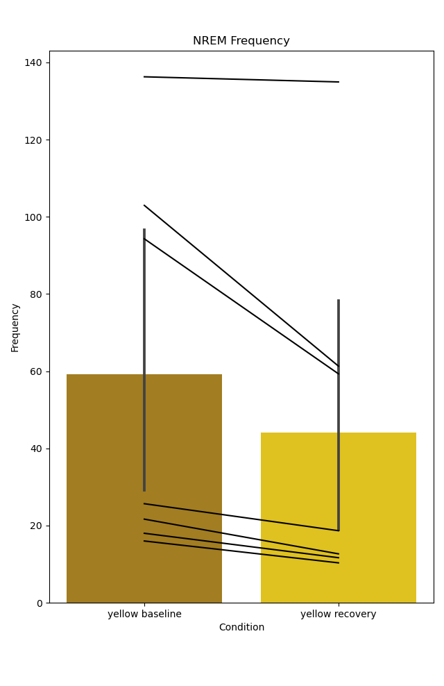
Sleep Summary Statistics
NREM, Baseline vs Recovery Sleep - Initial 3 hours
Green Food Mice
Yellow Food Mice
Percent
Duration
Frequency
Percent
Duration
Frequency

Slide 13
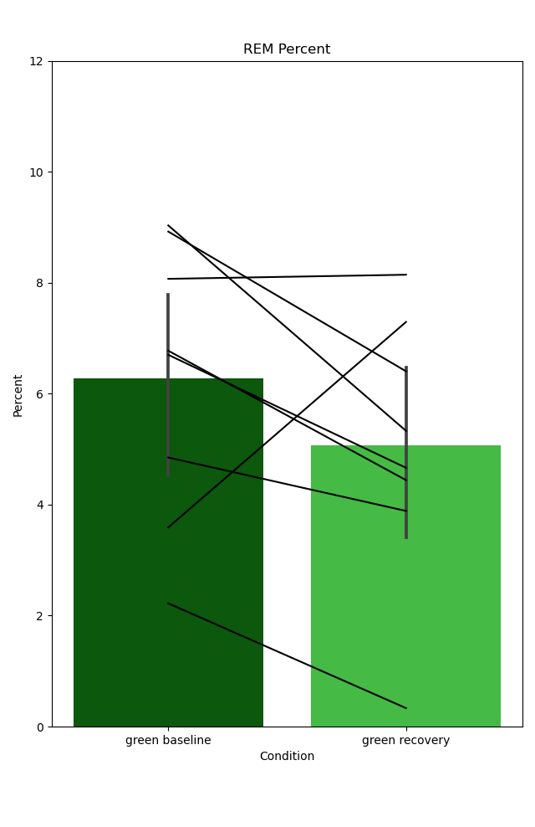
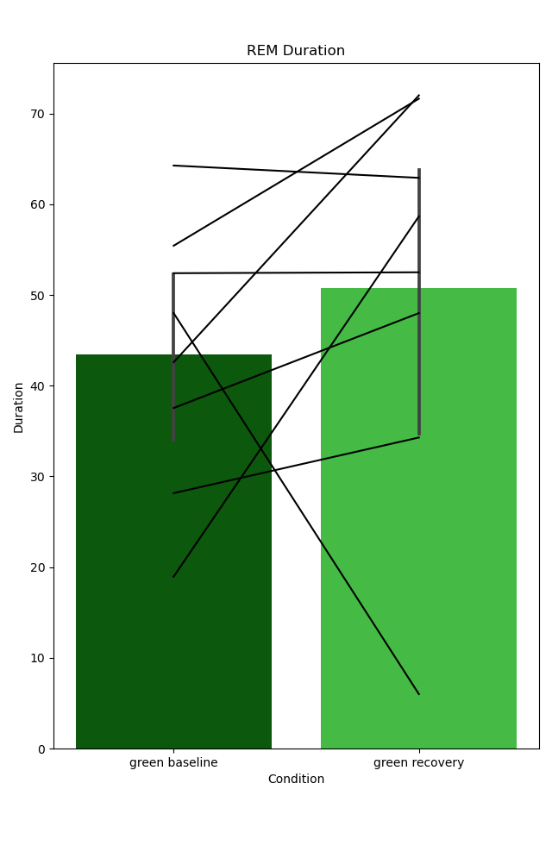
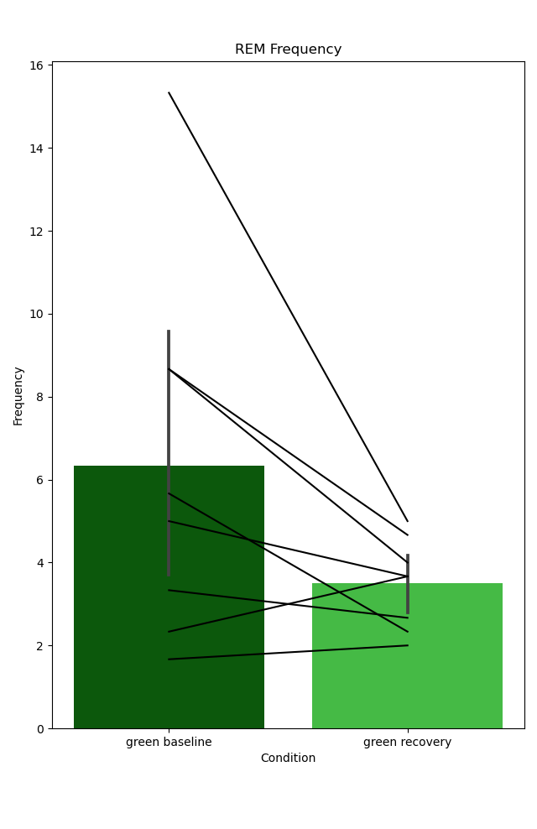
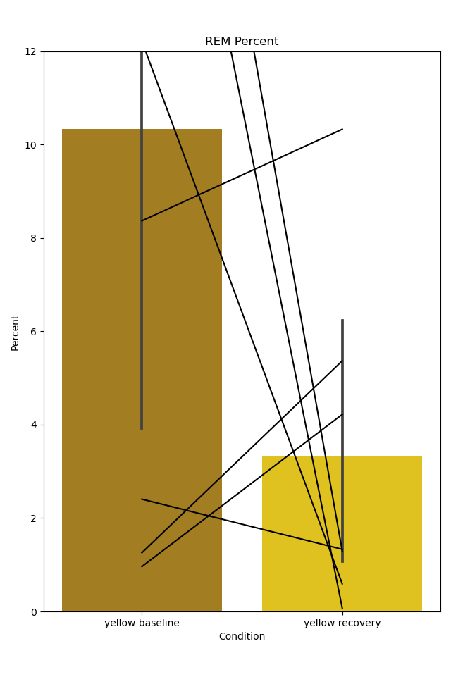
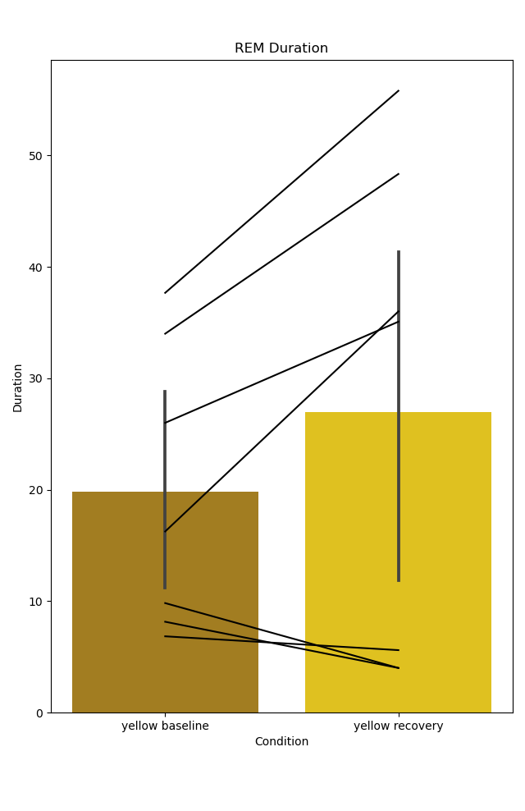
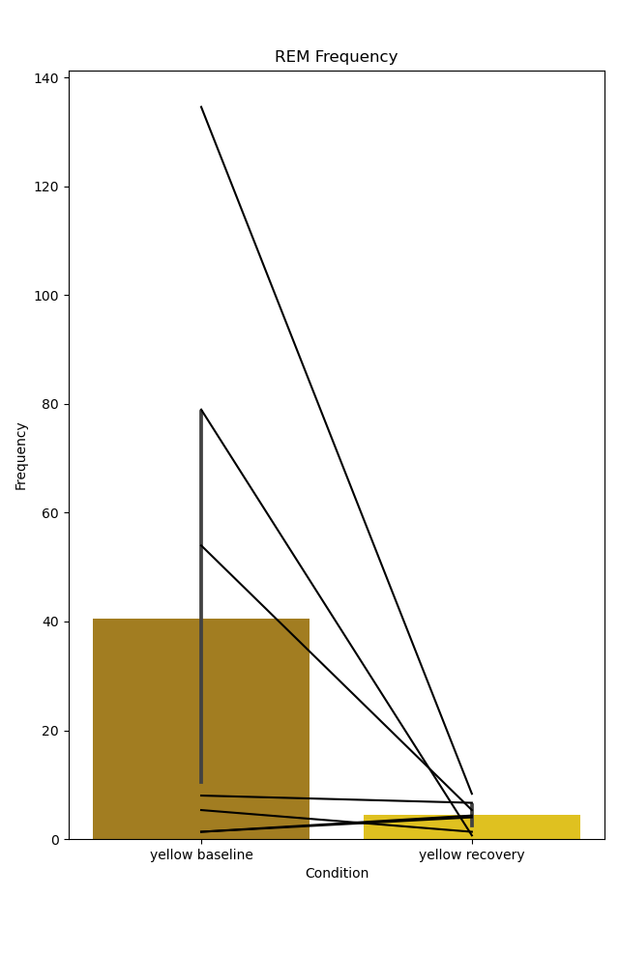
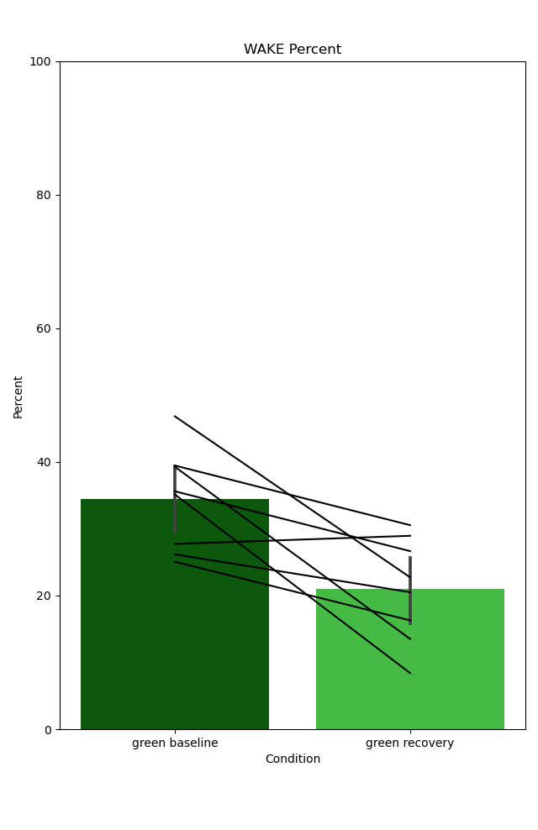
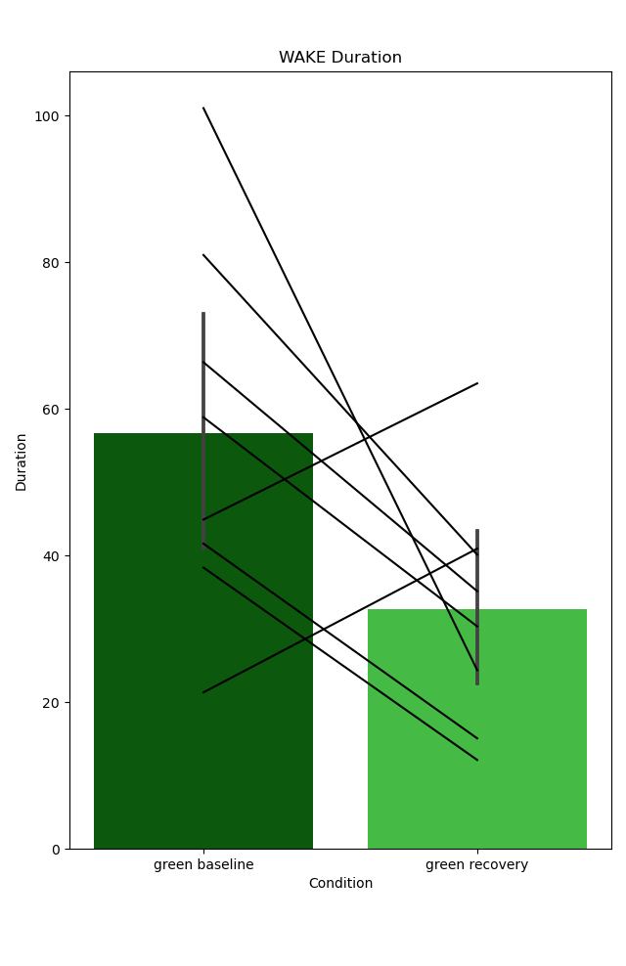
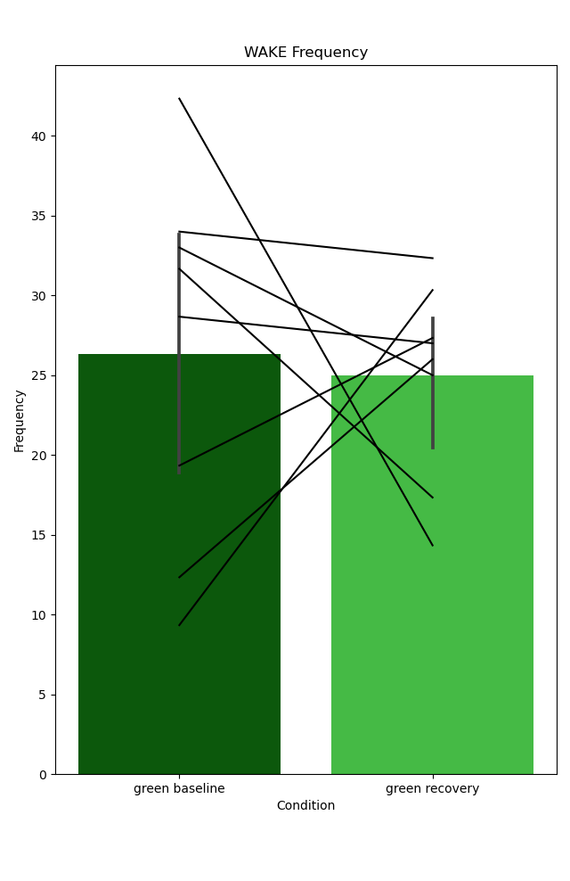
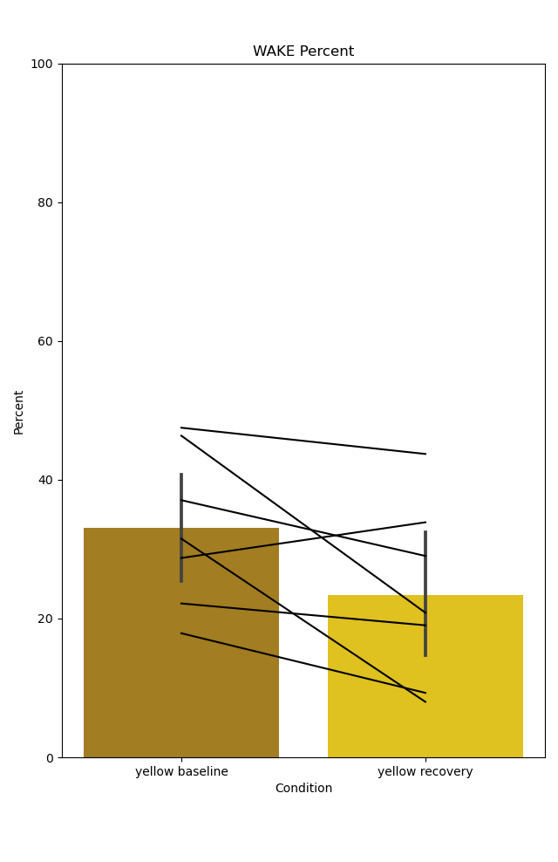
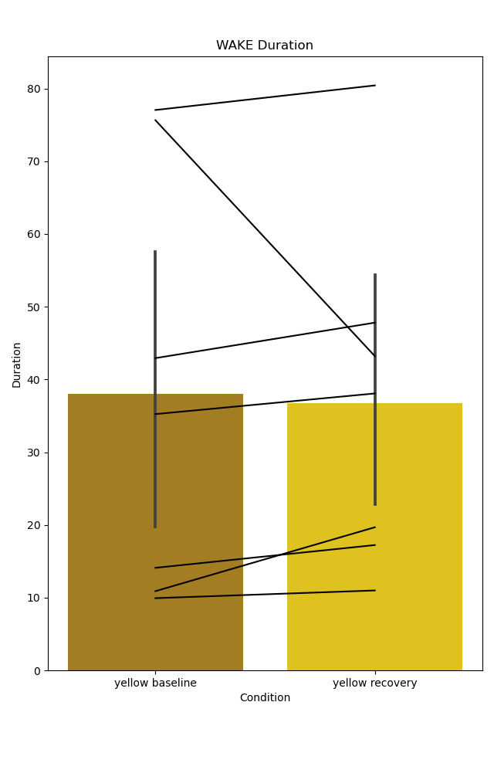
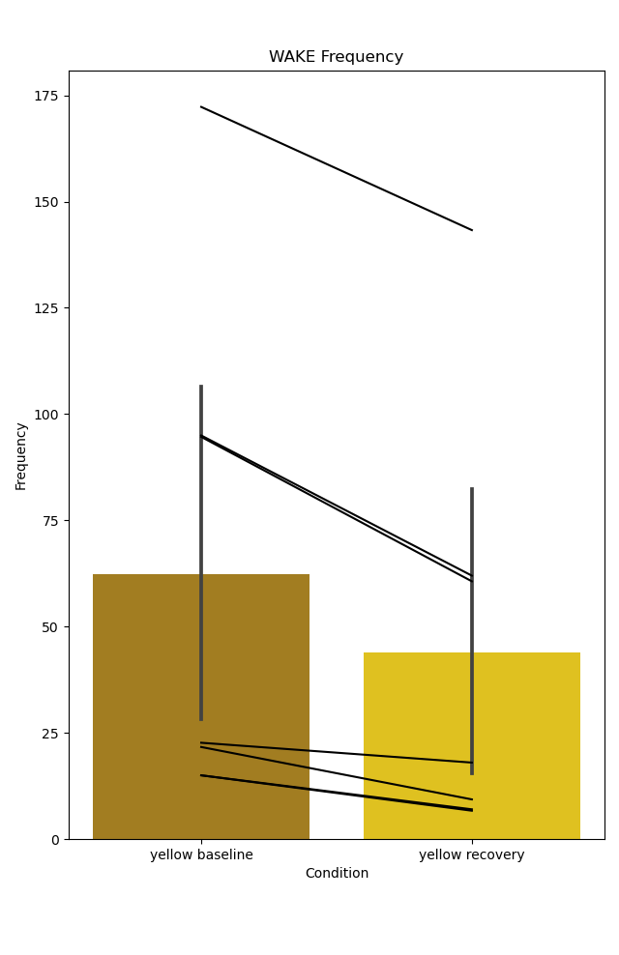
Percent
Duration
Frequency
Percent
Duration
Frequency
REM
REM
NREM
NREM
WAKE
WAKE

Slide 14
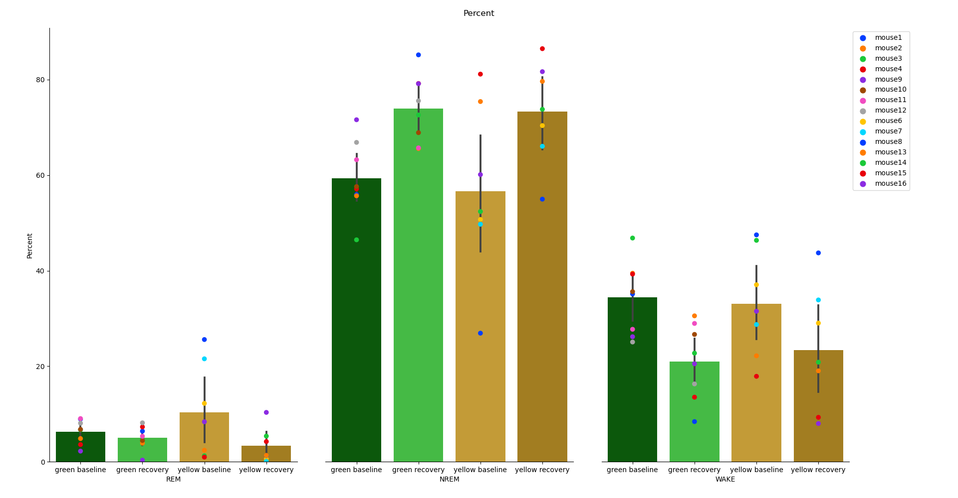
Combined Sleep Summary
Percent
REM
NREM
Wake
Baseline
Recovery
Baseline
Recovery

Slide 15
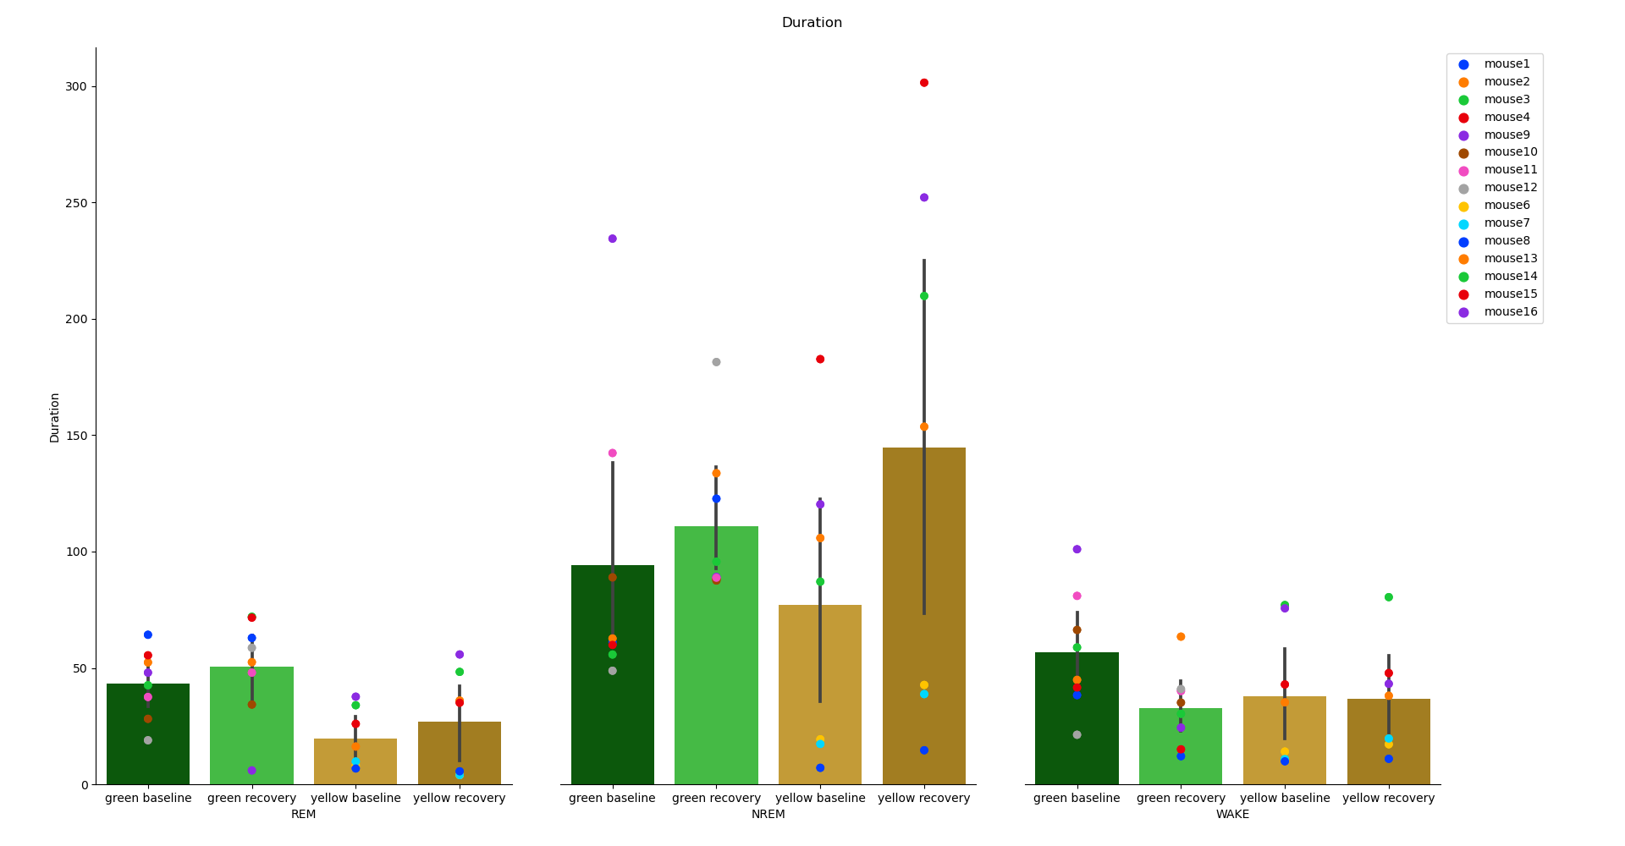
Combined Sleep Summary
Duration (s)
REM
NREM
Wake
Baseline
Recovery
Baseline
Recovery

Slide 16
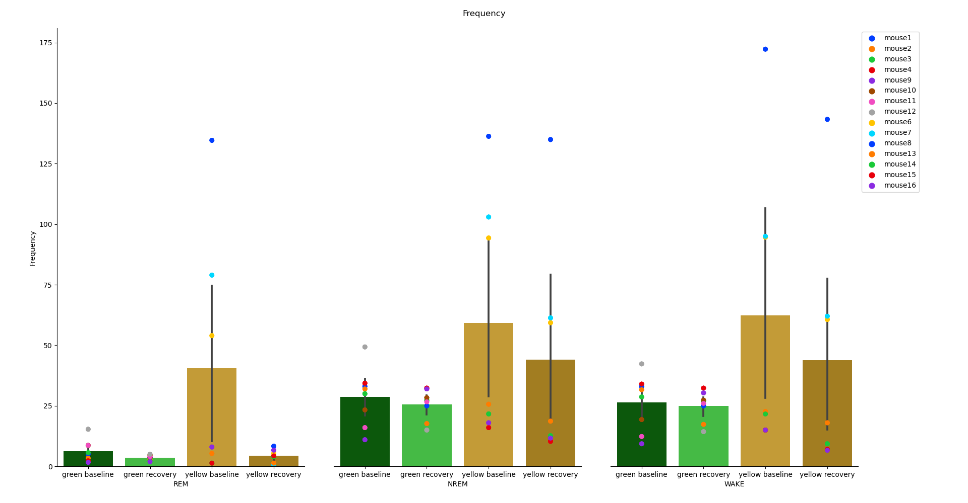
Combined Sleep Summary
Frequency (bouts per hour)
REM
NREM
Wake
Baseline
Recovery
Baseline
Recovery

Slide 17
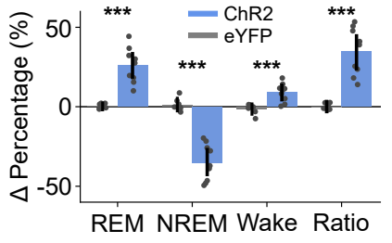
Future analyses – Comparing magnitude of state changes
NREM Percent
Change in Percent

Slide 18
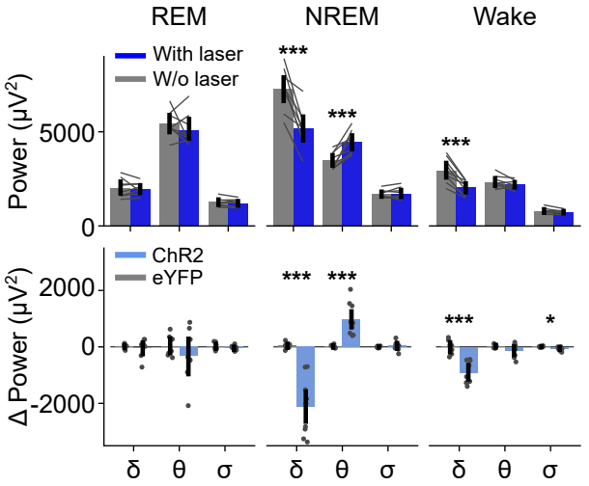
Future analyses – Comparing magnitude of frequency spectrum changes per state

